Slide 1
Chapter 5: Memory Management
Background
Swapping
Contiguous Allocation
Paging
Segmentation
Segmentation with Paging

Slide 2
Background
Address Binding:
Program resides on disk.
Program must be brought into memory and placed within a process for it to be run.
Input queue – collection of processes on the disk that are waiting to be brought into memory to run the program.
User programs go through several steps before being run.
Addresses in source program are symbolic. e.g. count.
Compiler binds Symbolic address to relocatable address.
Linkage editor / loader binds relocatable address to absolute (physical )address.

Slide 3
Binding of Instructions and Data to Memory
Address binding of instructions and data to memory addresses can happen at three different stages.
Compile time: If memory location known a priori, absolute code can be generated; must recompile code if starting location changes.
Load time: Must generate relocatable code if memory location is not known at compile time.
Execution time: Binding delayed until run time if the process can be moved during its execution from one memory segment to another. Need hardware support for address maps (e.g., base and limit registers).

Slide 4
Dynamic Loading
Routine is not loaded until it is called
Calling routine first checks whether other routine is loaded then it loads.
Better memory-space utilization; unused routine is never loaded.
Useful when large amounts of code are needed to handle infrequently occurring cases. e.g. error handling.

Slide 5
Dynamic Linking
Linking postponed until execution time.
Small piece of code, stub, used to locate the appropriate memory-resident library routine.
Stub replaces itself with the address of the routine, and executes the routine.
Operating system needed to check if routine is in processes’ memory address.
Dynamic linking is particularly useful for libraries.

Slide 6
Logical vs. Physical Address Space
The concept of a logical address space that is bound to a separate physical address space is central to proper memory management.
Logical address – generated by the CPU; also referred to as virtual address.
Physical address – address seen by the memory unit.
Logical and physical addresses are the same in compile-time and load-time address-binding schemes; logical (virtual) and physical addresses differ in execution-time address-binding scheme.

Slide 7
Memory-Management Unit (MMU)
Hardware device that maps virtual to physical address.
In MMU scheme, the value in the relocation register is added to every address generated by a user process at the time it is sent to memory.
The user program deals with logical addresses; it never sees the real physical addresses.

Slide 8
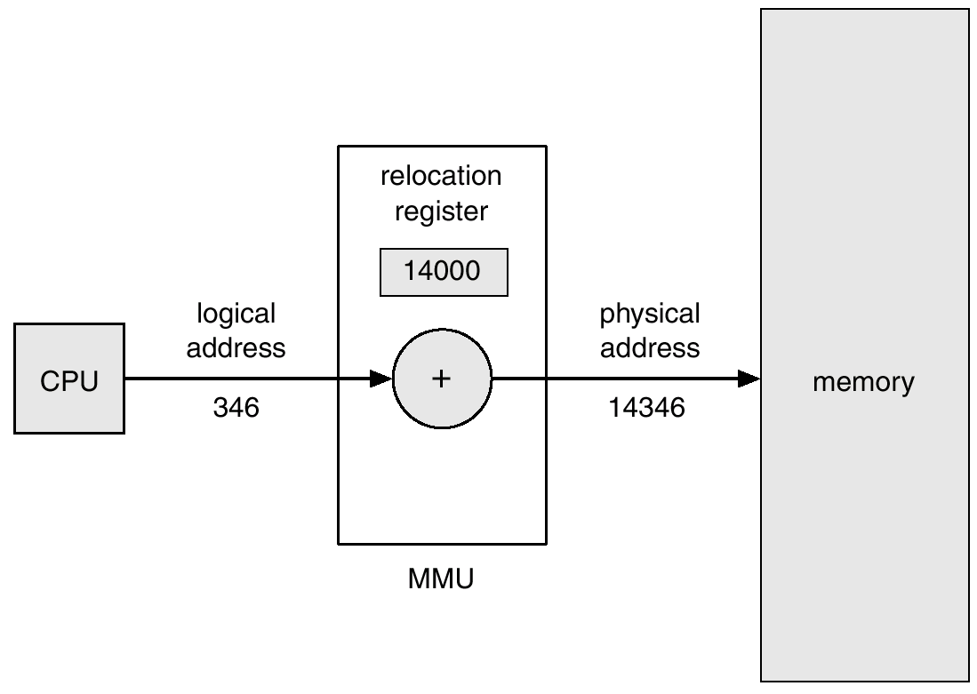
Dynamic relocation using a relocation register
Relocation is base register

Slide 9
Swapping
A process can be swapped temporarily out of memory to a backing store, and then brought back into memory for continued execution.
Backing store – fast disk large enough to accommodate copies of all memory images for all users; must provide direct access to these memory images.
Roll out, roll in – swapping variant used for priority-based scheduling algorithms; lower-priority process is swapped out so higher-priority process can be loaded and executed.
Major part of swap time is transfer time; total transfer time is directly proportional to the amount of memory swapped.
Modified versions of swapping are found on many systems, i.e., UNIX, Linux, and Windows.

Slide 10
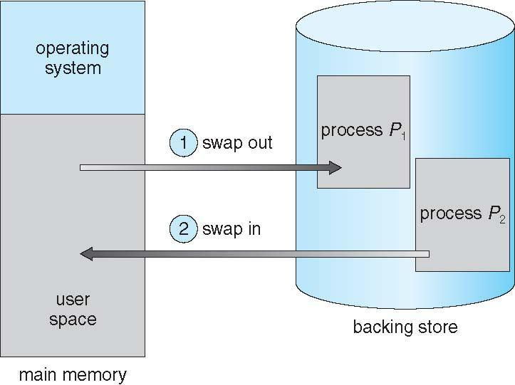
Schematic View of Swapping

Slide 11
Contiguous Allocation
Main memory usually into two partitions:
Resident operating system, usually held in low memory with interrupt vector.
User processes then held in high memory.
Single-partition allocation
OS is need to be protected from malicious user processes & protect processes from each other.
Relocation-register scheme used to protect user processes from each other, and from changing operating-system code and data.
Relocation register contains value of smallest physical address; limit register contains range of logical addresses – each logical address must be less than the limit register.
OS
User

Slide 12
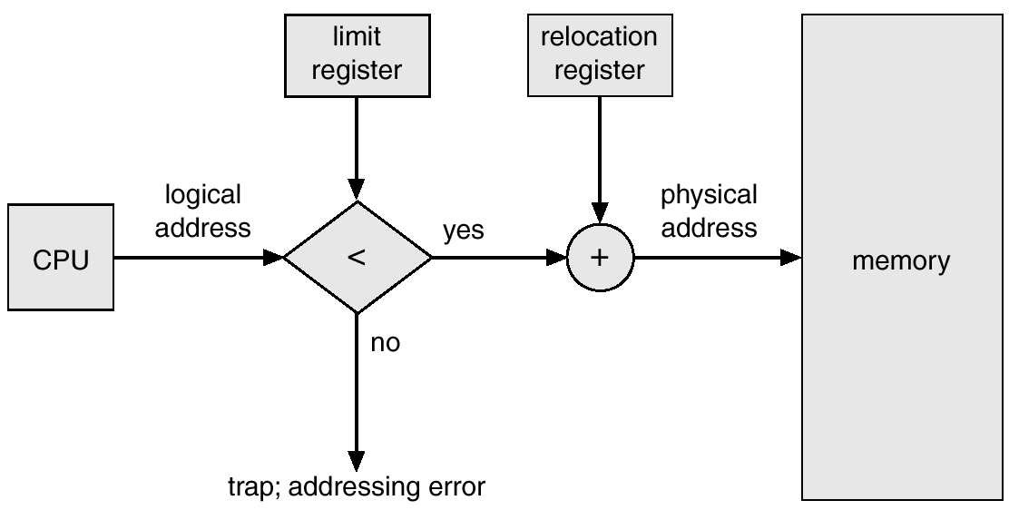
Hardware Support for Relocation and Limit Registers

Slide 13
Contiguous Allocation (Cont.)
Multiple-partition allocation
Hole – block of available memory; holes of various size are scattered throughout memory.
When a process arrives, it is allocated memory from a hole large enough to accommodate it.
Operating system maintains information about: a) allocated partitions b) free partitions (hole)
OS
OS
OS
OS
process 5
process 5
process 5
process 5
process 9
process 9
process 8
process 10
process 2
process 2
process 2
process 2

Slide 14
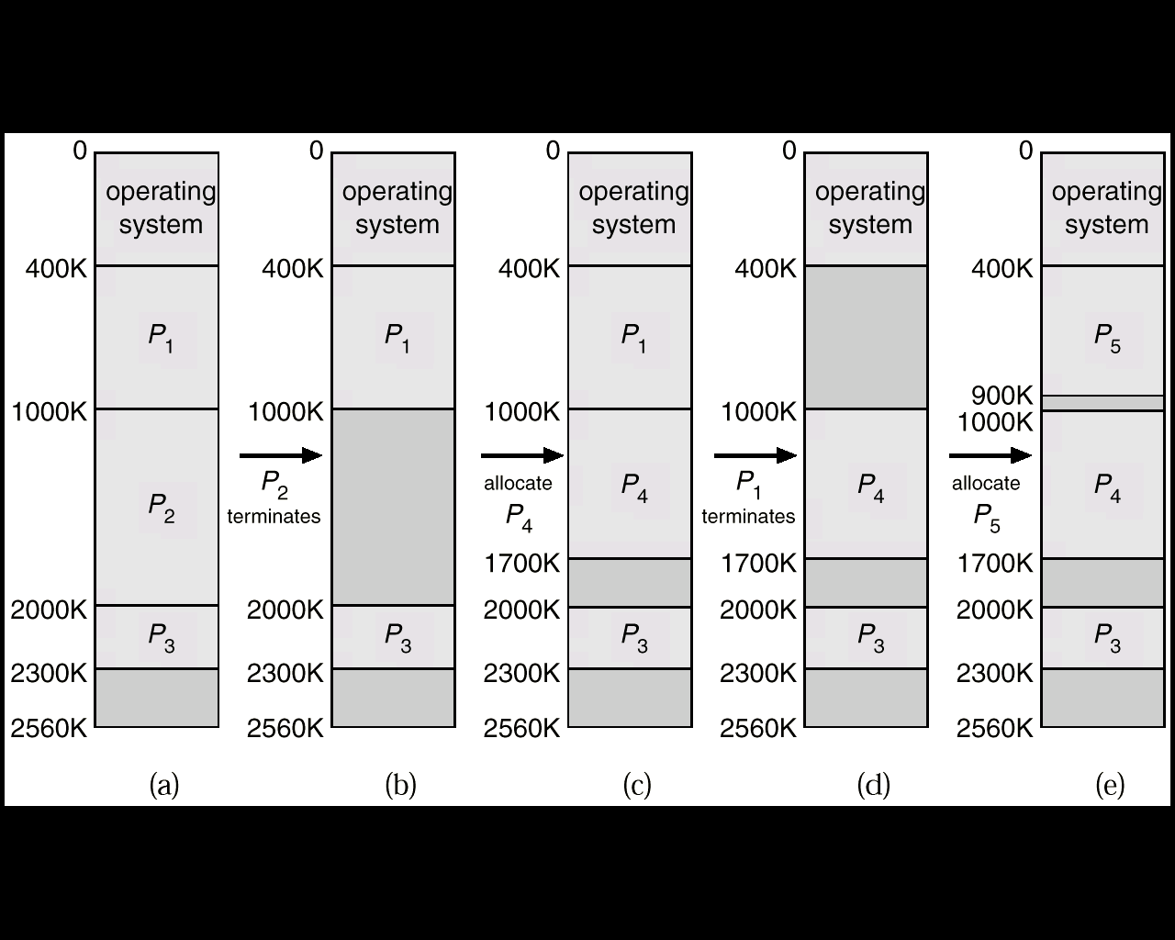
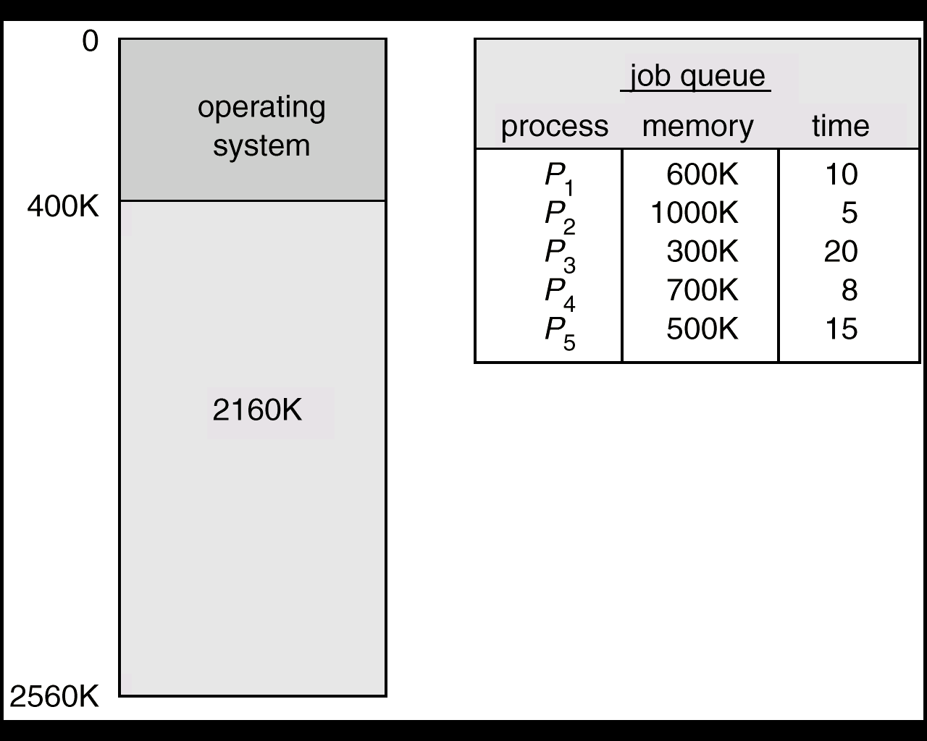
Multiple partition Allocation
How to satisfy request of size n from list of free holes?

Slide 15
Dynamic Storage-Allocation Problem
How to satisfy a request of size n from a list of free holes.
First-fit: Allocate the first hole that is big enough.
Best-fit: Allocate the smallest hole that is big enough; must search entire list, unless ordered by size. Produces the smallest leftover hole.
Worst-fit: Allocate the largest hole; must also search entire list. Produces the largest leftover hole.
First-fit and best-fit better than worst-fit in terms of speed and storage utilization.

Slide 16

Fragmentation
External Fragmentation – total memory space exists to satisfy a request, but it is not contiguous. It is fragmented into a large number of small holes.
Example: We have a total external fragmentation of (300+260)=560KB.
If P5 is 500KB, then this space would be large enough to run P5.
But the space is not contiguous.

Slide 17
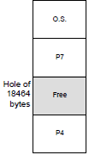
Fragmentation
Internal Fragmentation – allocated memory may be slightly larger than requested memory; this size difference is memory internal to a partition, but not being used.
Example: Assume next request is for 18462 bytes.
– If we allocate exactly the requested block, we are left with a hole of 2 bytes.
The overhead to keep track of this hole will be larger than the hole itself. So, we ignore this small hole (internal fragmentation).

Slide 18
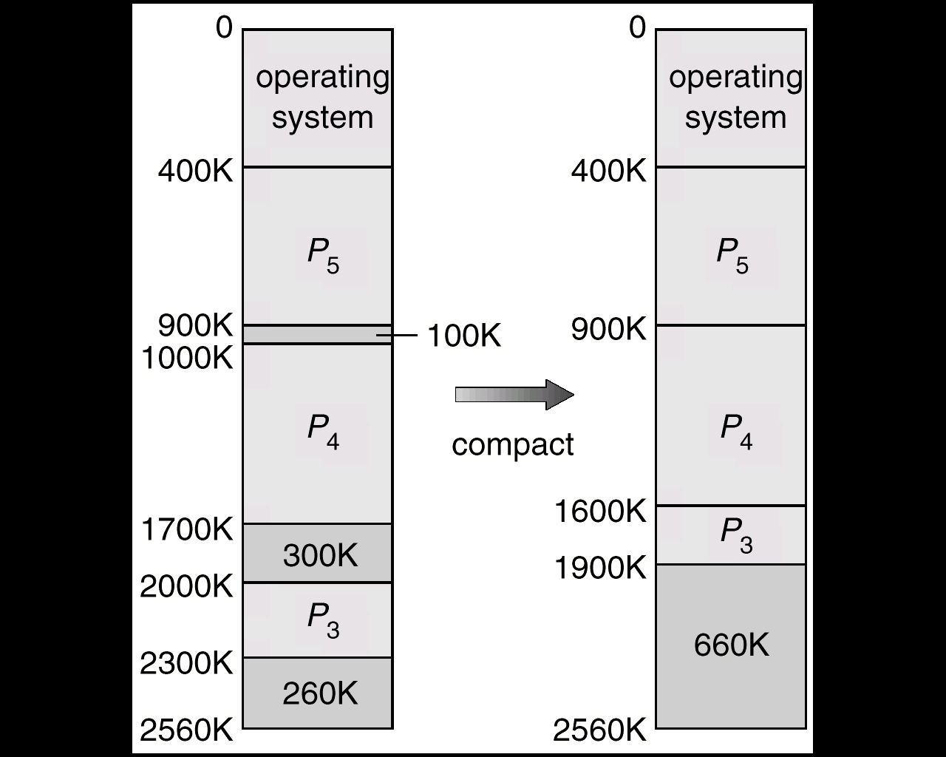
External fragmentation: Solution
Reduce external fragmentation by compaction
Shuffle memory contents to place all free memory together in one large block.
Compaction is possible only if relocation is dynamic, and is done at execution time.

Slide 19
Paging
Logical address space of a process can be noncontiguous; process is allocated physical memory whenever the latter is available.
Divide physical memory into fixed-sized blocks called frames (size is power of 2, between 512 bytes and 8192 bytes).
Divide logical memory into blocks of same size called pages.
Keep track of all free frames.
To run a program of size n pages, need to find n free frames and load program.
Set up a page table to translate logical to physical addresses.
Internal fragmentation: No external fragmentation, but have some internal fragmentation.(if pages are 512 bytes, a process of 1280 bytes would need 2 pages plus 256 bytes.)

Slide 20
Address Translation Scheme
Address generated by CPU is divided into:
Page number (p) – used as an index into a page table which contains base address of each page in physical memory.
Page offset (d) – combined with base address to define the physical memory address that is sent to the memory unit.
Page number page offset
( m – n ) n
Higher bits Lower bits
P d

Slide 21
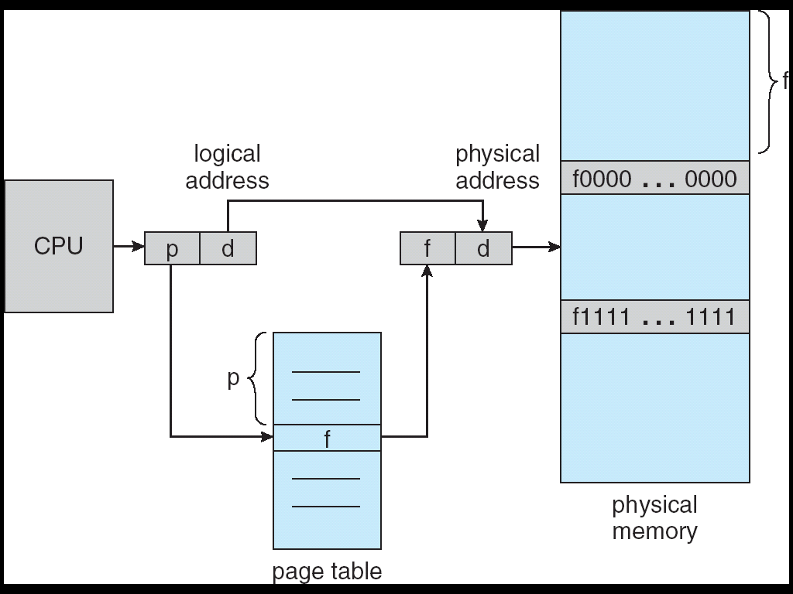
Address Translation Architecture

Slide 22
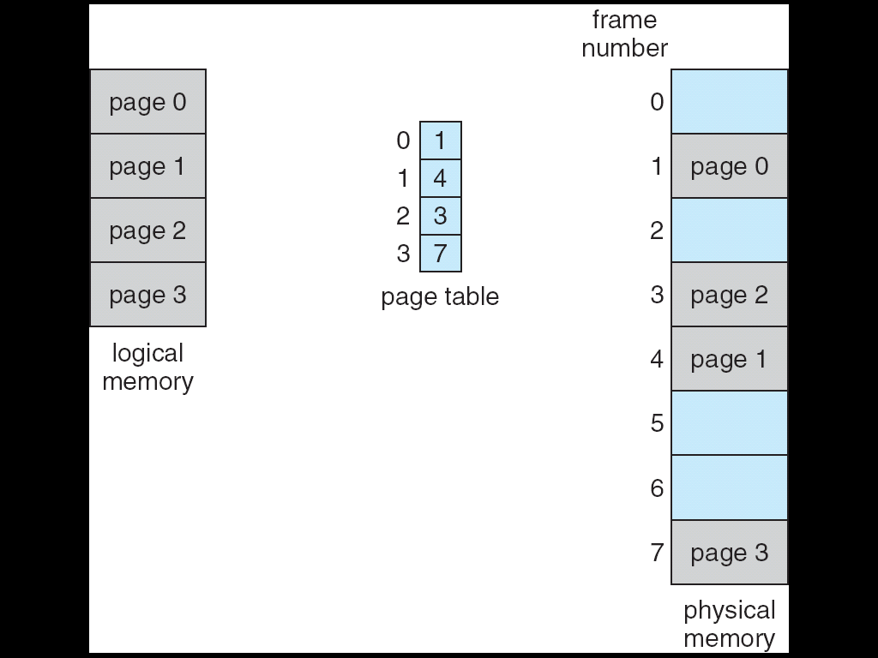
Paging Example

Slide 23
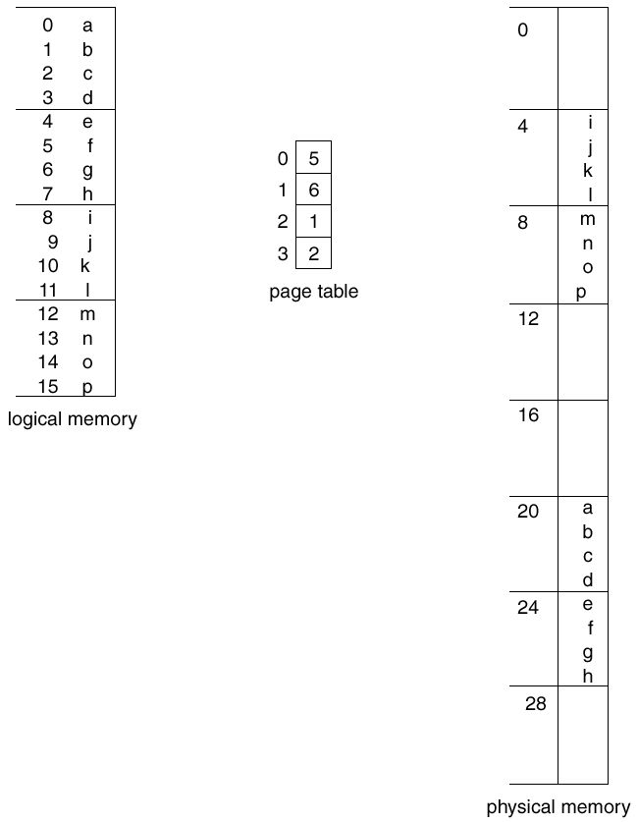
Paging Example: for a 32-byte memory with 4 byte pages
Logical memory space=2⁴=16 bytes
Page size=2²=4 bytes
m=4
n=2
m-n = page no bits
N=offset bits
Logical address 0, is page 0, offset = 0
So physical address= (5 * 4) + 0 = 20
Logical address 3, is page 0, offset = 3
So physical address = ( 5 * 4) + 3 = 23
Page table contains frame no.

Slide 24
As a concrete (although minuscule) example, consider the memory in Figure 8.9.
Here, in the logical address, n= 2 and m = 4. Using a page size of 4 bytes and a physical memory of 32 bytes (8 pages), we show how the user's view of memory can be mapped into physical memory. Logical address 0 is page 0, offset 0.
Indexing into the page table, we find that page 0 is in frame 5. Thus, logical address 0 maps to physical address 20 [= (5 x 4) + 0].
Logical address 3 (page 0, offset 3) maps to physical address 23 [ = (5 x 4) + 3].
Logical address 4 is page 1, offset 0; according to the page table, page 1 is mapped to
frame 6.
Thus, logical address 4 maps to physical address 24 [ = ( 6 x 4) + O].
Logical address 13 maps to physical address 9.

Slide 25
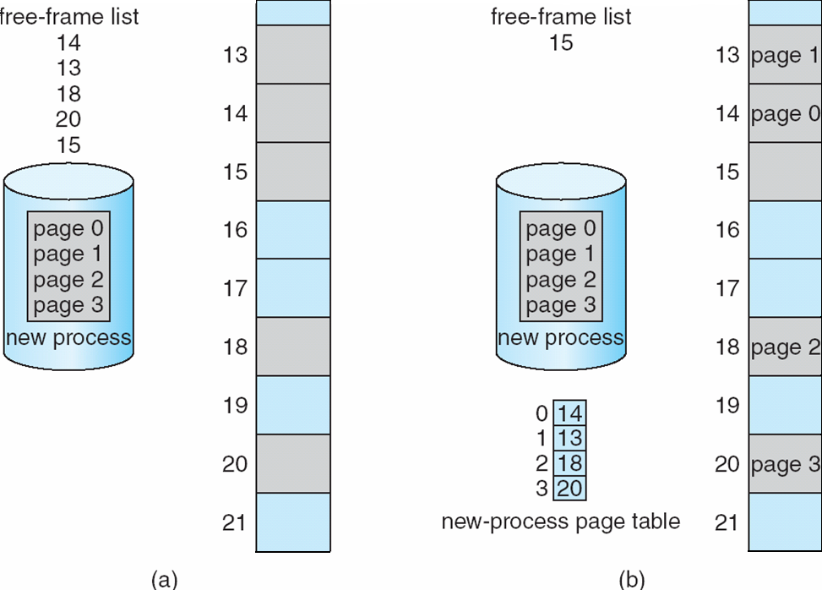
Free Frames
Before allocation
After allocation

Slide 26
Memory Protection
Memory protection implemented by associating protection bit with each frame.
One bit can define a page to be read-write or read only. Every reference to memory goes through the page table to find correct frame number. While computing physical address, protection bits are checked to verify, no writers are being made to read-only page.
Illegal attempts are trapped by OS. One more bit is Valid-invalid bit
Valid-invalid bit attached to each entry in the page table:
“valid” indicates that the associated page is in the process’ logical address space, and is thus a legal page.
“invalid” indicates that the page is not in the process’ logical address space.

Slide 27
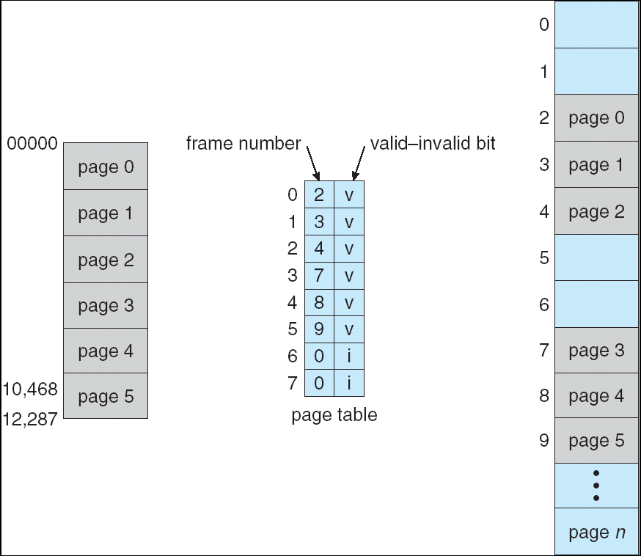
Valid (v) or Invalid (i) Bit In A Page Table
Consider a system with 14 bit address space (0 - 16383)
1 page = 2 KB = 2¹¹ = 2048 bytes
A program requires address space 0 - 10468
Here only 0-5 pages are valid, attempts to access page 6 & 7 set protection bit to invalid. Page 5 is classified as valid so, addresses upto 12, 287 are valid & addresess from 12288-16383 are invalid.
2047
4095
6143
8191
10239
Internal
Fragmentation

Slide 28
Segmentation
Memory-management scheme that supports user view of memory.
User prefer to see memory as collection of variable length segments than logical address space as array of bytes.
A program is a collection of segments. A segment is a logical unit such as:
main program,
procedure,
function,
method,
object,
local variables, global variables,
common block,
stack,
symbol table, arrays
Compiler automatically constructs segments of input program.

Slide 29
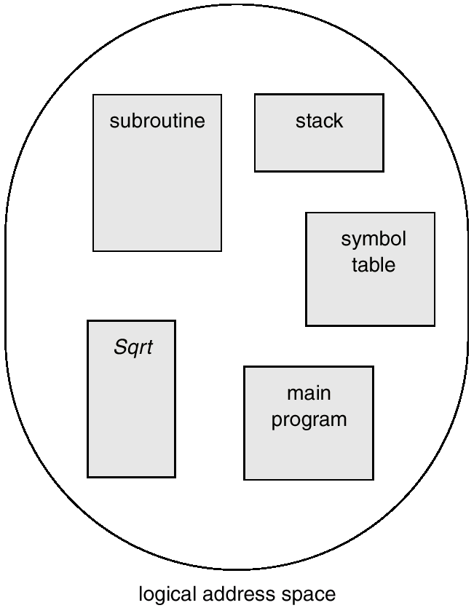
User’s View of a Program
Segments without caring what addresses in memory these elements occupy

Slide 30
Logical View of Segmentation
1
1
4
2
3
4
2
3
user space
physical memory space

Slide 31
Segmentation Architecture
Logical address space is collection of segments. Each segment has name & length.
Logical address consists of a two tuple:
<segment-number, offset>,
for simplicity segment number than name
Segment table – maps two-dimensional physical addresses; each table entry has:
Segment base – contains the starting physical address where the segments reside in memory.
Segment limit – specifies the length of the segment.
Segment-table base register (STBR) points to the segment table’s location in memory.
Segment-table length register (STLR) indicates number of segments used by a program;

Slide 32
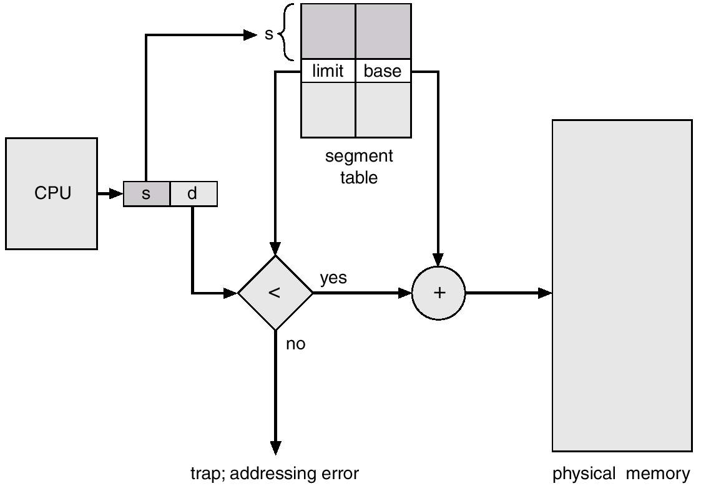
Segmentation Hardware
Segment no as index
Offset must be less than limit

Slide 33
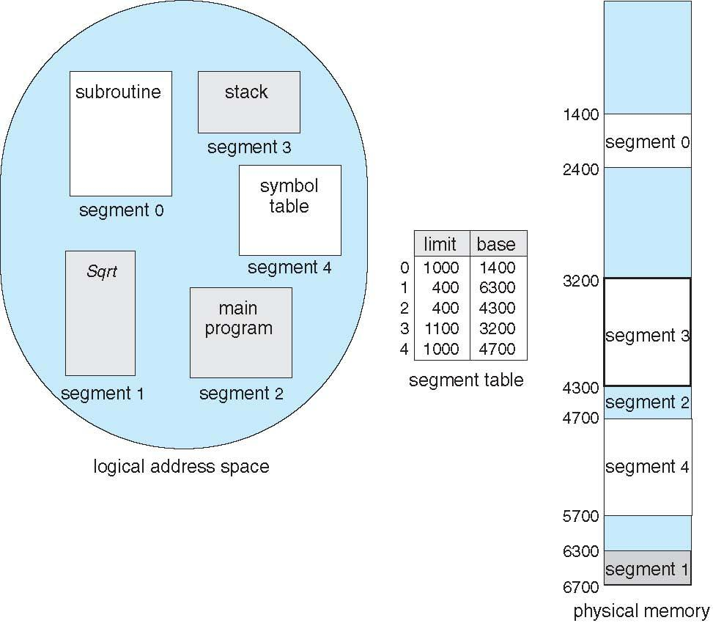
Example of Segmentation
Segment 2 is 400 bytes long & begins at 4300, byte 53 will be mapped to 4300+53=4353.
1222 byte of segment 0 will generate error.

Slide 34
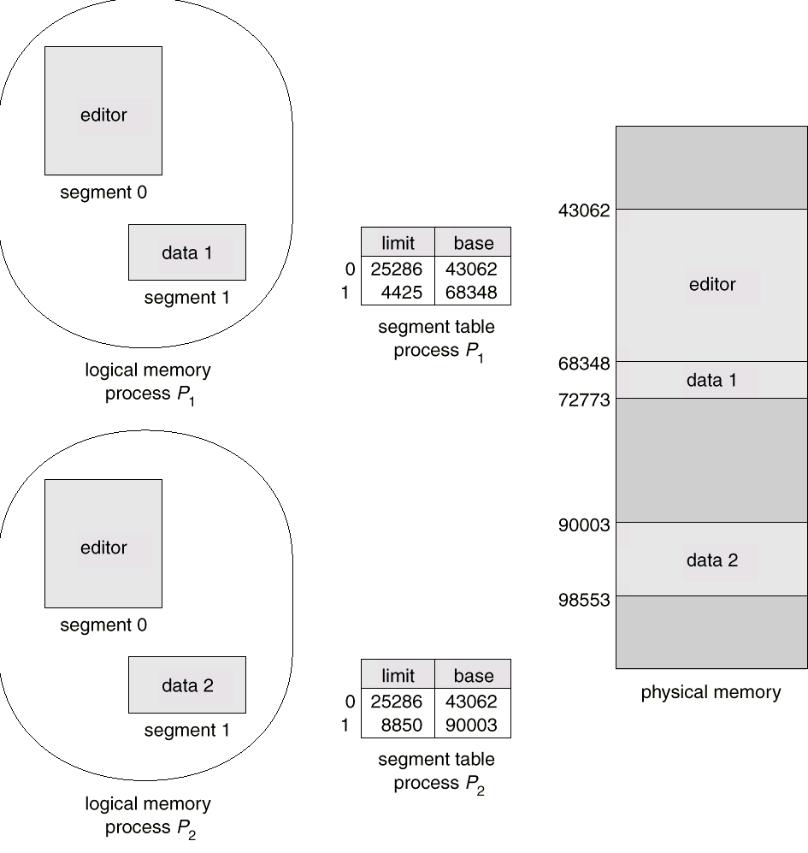
Sharing of Segments

Slide 35
Segment Protection and Sharing
With each entry of segment table associate:
Validation bit = 0 => illegal segment
Read/write/execute privilege
Protection bits associated with segments; code sharing occurs a segment level.
Sharing is simple but subtle consideration. Code segment contain references. Conditional branching may give transfer address and segment number of code segment is segment number of transfer address. Sqrt( ) function may get segment no 4 in one process & seg no 17 by another process.

Slide 36
Fragmentation
Segmentation cause external fragmentation, when all blocks of free memory are too small to accommodate a segment.
In this case, the process may simply have to wait :
until more memory (or at least a larger hole) becomes available, or
until compaction creates a larger hole.
Solution:
Define each process to be one segment, which reduces to the variable-sized partition scheme.
At the other extreme, each byte as segment . Then every byte need a base register for its relocation, doubling memory use!
Next logical solution is fixed-sized, small segments ---is paging.

Slide 37
Segmentation with Paging
This solution differs from pure segmentation in that the segment-table entry contains not the base address of the segment, but rather the base address of a page table for this segment.

Slide 38
Segmentation with Paging – Intel 386
The 386 uses segmentation with paging for memory management.
Maximum number of segments per process = 16 KB
Each segment can be as large as 4 GB= 2^{32 bytes.}.
Page size is 4 KB.
Logical-address space of a process is divided into 2 partitions.
Up to 8 KB segments that are private to that process. kept in the local descriptor table (LDT)
Up to 8 KB segments that are shared among
all the processes. kept in the global descriptor table (GDT).

Slide 39
Segmentation with Paging – Intel 386
Each segment is paged.
Logical address is pair of (selector, offset).
First logical address is converted into linear address to give page directory, page and offset.
Then linear address is converted into physical address
S g P
Segment no GDT or LDT Protection bit

Slide 40
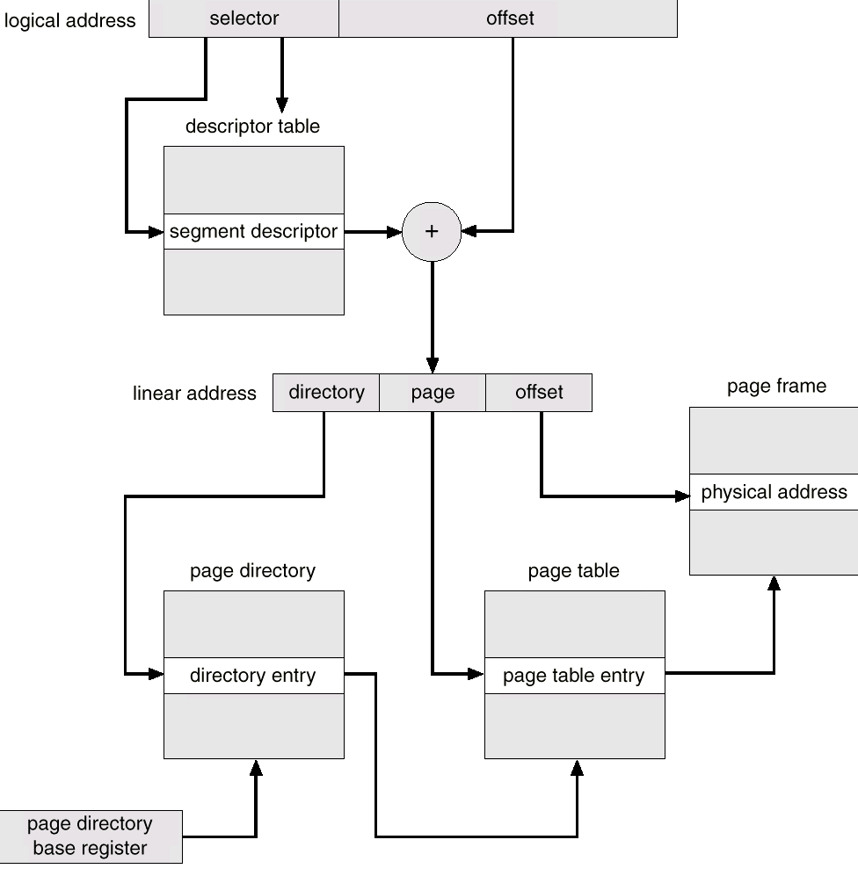
Intel 30386 Address Translation
Segmentation mechanism
Paging mechanism

